Slide 1
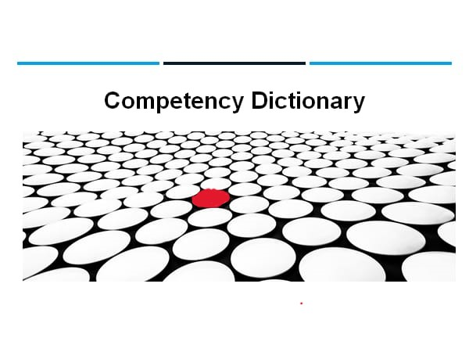
Anomaly detection
N180936-Y.Chandrika
N180830-K.Swathi
N180730-Ch.Hemantha Rajasri
N181115-B.Amrutha
--- USING ISOLATION FOREST

Slide 2
CONTENTS
INTRODUCTION
--- INTERFACING OF SENSORS
--- TEMPERATURE AND HUMIDITY SENSOR (DHT11)
--- NODEMCU (ESP8266)
INTRODUCTION TO THINGSPEAK
--- INTERFACING DHT11 SENSOR WITH NODEMCU (ESP8266)
--- DOWNLOADING CSV FILES IN THINGSPEAK
LOADING THE CSV FILE IN JUPYTER
MACHINE LEARNING MODEL FOR IDENTIFYING ABNORMALITIES
--- USING ISOLATION FOREST ALGORITHM TO DETECT ABNORMAL VALUES
ABOUT TWILIO APPLICATION TO SEND SMS AND EMAIL
--- INTEGRATING ISOLATION FOREST AND TWILIO

Slide 3
INTRODUCTION
By integrating various hardware and software components, communication protocols, cloud or server platforms and security measures, a DAQ system can be configured to meet the specific needs of various industries and applications.
INTERFACING OF SENSORS:
In this presentation, we will explore the exciting possibilities of connecting sensors to Nodemcu and transmitting data to the cloud. We interface a temperature and humidity sensor with Nodemcu and transmit the data to Thingspeak. By the end of this presentation, we will have a clear understanding of the concept of interfacing sensors, Nodemcu, and Thingspeak.

Slide 4
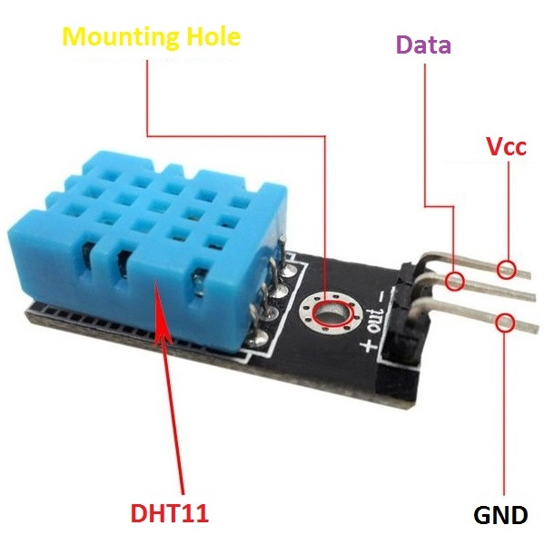
Temperature and humidity sensor (DHT11)
Normal temperature sensor range will be -55 to +125 degree celsius.
Normal temperatures during pregnancy, one study found that body temperature peaks at 96-99.5°F (35.6-37.5°C) around the 12th week of pregnancy. The average body temperature reaches its lowest point of around 95.5-99.1°F (35.3- 37.3°C) just after the 33rd week.
Range of Humidity Sensor:
Most importantly, keep humidity levels between 30 and 50% to prevent excess moisture.

Slide 5
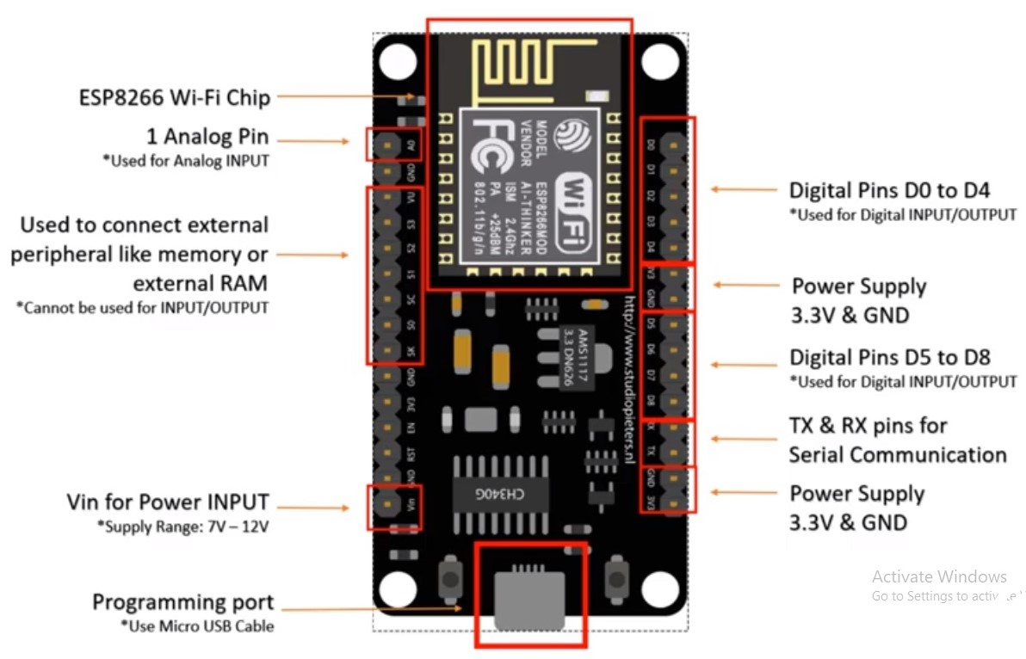
NODEMCU – ESP8266
Nodemcu is an open-source firmware and development
board that is based on the ESP8266 WiFi module.
It provides a complete and self-contained Wi-Fi networking
solution, allowing sensors to connect to the internet and
transmit data to the cloud without the need for an external
microcontroller.
Nodemcu supports scripting language, making it easy to
program and interface with sensors.
It also has a built-in USB-to-serial converter, which simplifies
the process of uploading code and debugging.
With its small size and low power consumption, Nodemcu is
ideal for IoT projects that require wireless connectivity and sensor interfacing.

Slide 6
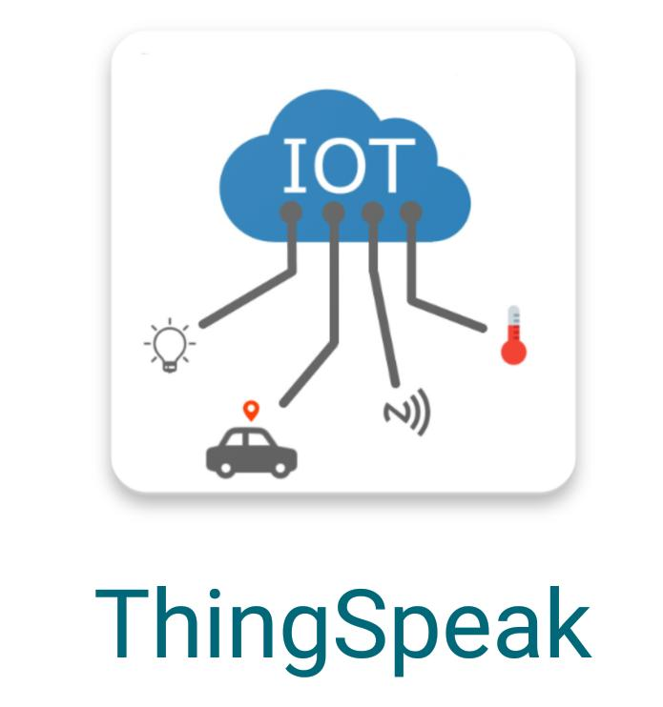
INTRODUCTION TO THINGSPEAK
Thingspeak is an open-source Internet of Things (IoT) platform that enables the collection, visualization, and analysis of sensor data.
It provides a simple and easy-to-use interface for users to upload their data and create custom applications for data analysis.
With Thingspeak, users can monitor and control devices remotely, receive alerts based on sensor data, and automate tasks based on specific conditions.
For example monitoring air quality in a city using sensors and visualizing the data on Thingspeak's platform.

Slide 7
INTERFACING DHT11 SENSOR WITH NODEMCU (ESP8266) TO THINGSPEAK
To interface a temperature and humidity sensor with Nodemcu and transmit the data to Thingspeak, follow these step-by-step instructions:
1. Connect the sensor to the Nodemcu board using jumper wires.
2. Write a program in Arduino IDE to read the data from the sensor.
3. Use the WiFi library to connect the Nodemcu board to the internet.
4. Create a Thingspeak account and obtain an API key.
5. Use the HTTPClient library to send the data to Thingspeak.
6. Verify that the data is being transmitted successfully by checking the Thingspeak dashboard.

Slide 8
Downloading CSV Files in Thingspeak
In addition to monitoring temperature and humidity levels, developers can also download data from Thingspeak in CSV format.
This allows for easy analysis of historical data and the ability to create custom visualizations.
To download a CSV file, simply navigate to the channel's page and click on the 'Export Data' button.
From here, developers can select the date range they wish to export and choose which fields they want to include.
Once the options have been selected, clicking 'Download' will generate a CSV file that can be opened in any spreadsheet program.

Slide 9
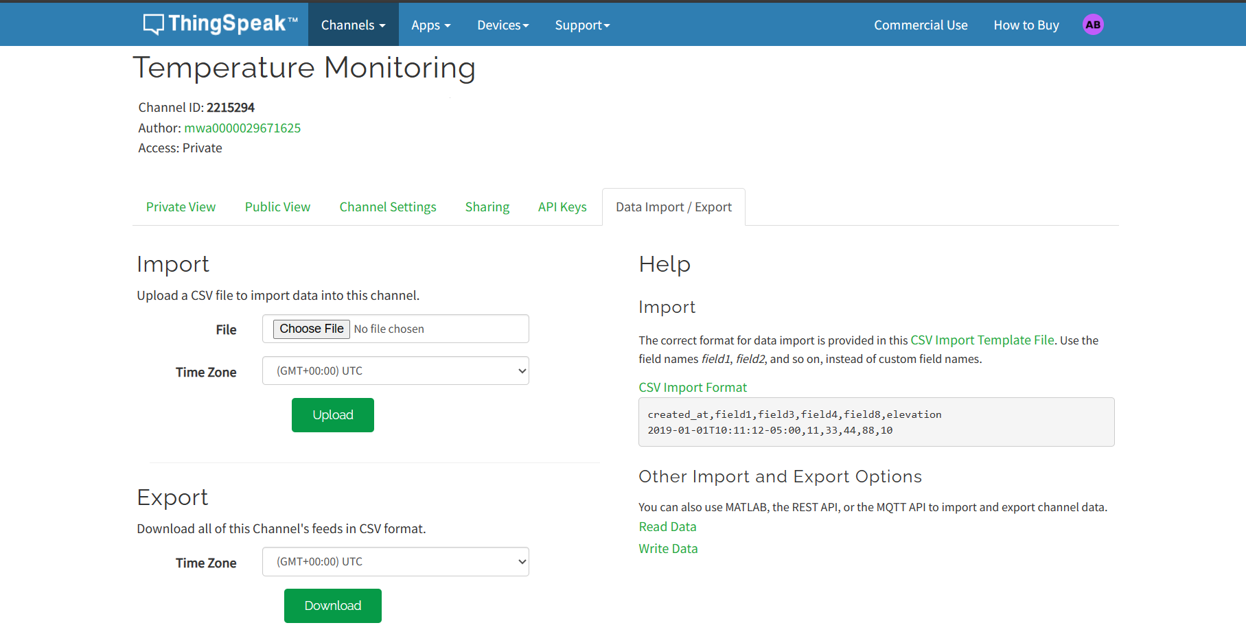

Slide 10
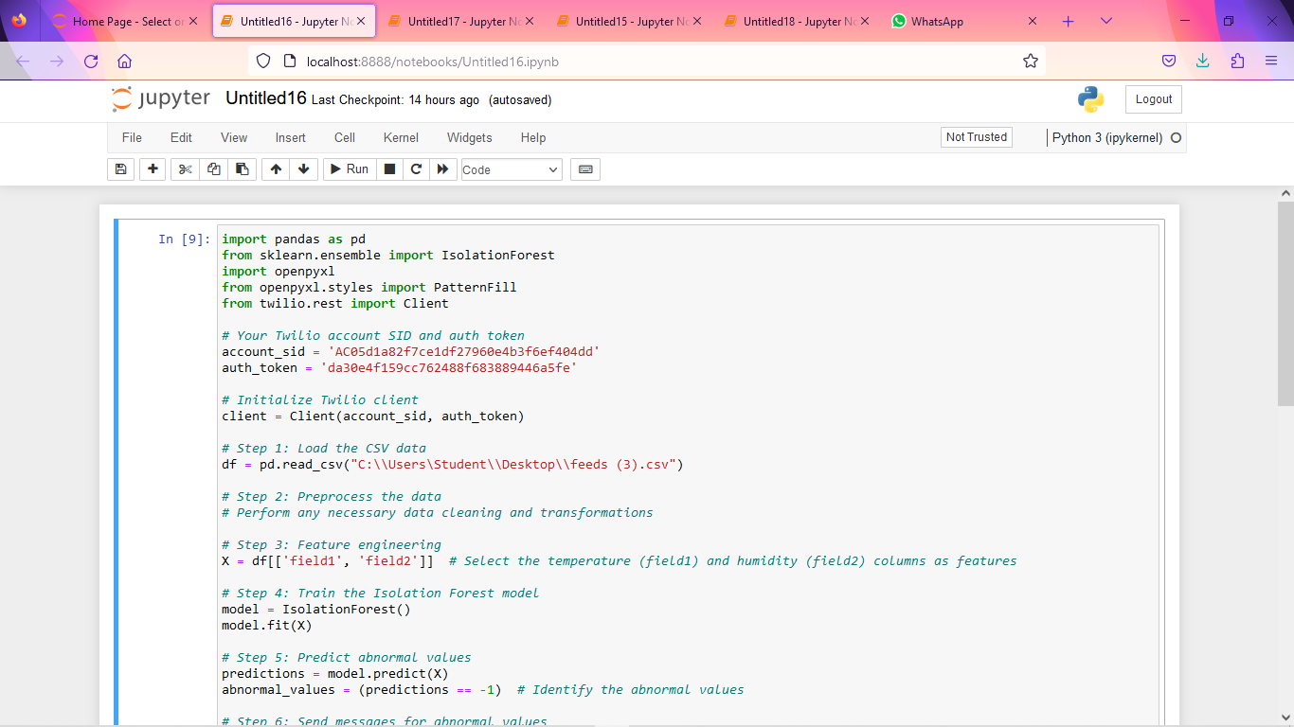
LOADING THE CSV FILE IN JUPYTER
After downloading the CSV file from Thingspeak, developers can load it into Jupyter to read the dataset.
This makes it easy to analyze historical data and create custom visualizations.
With Jupyter, developers can use Python code to manipulate and visualize the data in a variety of ways.
To load the CSV file in Jupyter, developers simply need to use the Pandas library's read_csv function.
This will import the data into a Pandas dataframe, which can then be manipulated using Python code. From here, developers can create custom visualizations, perform statistical analysis, and more.

Slide 11
MACHINE LEARNING MODEL FOR IDENTIFYING ABNORMALITIES
In this section, we will discuss the use of machine learning to identify abnormal values in temperature and humidity data collected from sensors.
Specifically, we will be using the isolation forest algorithm to detect anomalies in the data.
This algorithm works by isolating observations that are different from other observations in the dataset, making it ideal for identifying outliers.
Once an abnormal value is detected, a message will be sent to both the patient and doctor using the Twilio app.
This will enable them to take appropriate action to address the issue, whether it's adjusting medication or seeking medical attention.

Slide 13
Using Isolation Forest Algorithm to Detect Abnormal Values
The isolation forest algorithm is a machine learning technique that can be used to detect anomalies in data.
It works by isolating observations that are different from other observations in the dataset, making it ideal for identifying outliers.
This algorithm is particularly useful when dealing with high-dimensional data and can be applied to a wide range of applications, including fraud detection, network intrusion detection, and outlier detection.
The isolation forest algorithm is based on the principle of randomly partitioning the data into subsets. Each subset is then split again until each observation is in its own subset.
The number of splits required to isolate an observation is used as a measure of its abnormality. The algorithm is efficient and can be scaled to handle large datasets with millions of observations.
In our case, we will be using this algorithm to detect abnormal values in temperature and humidity data collected from sensors.

Slide 14
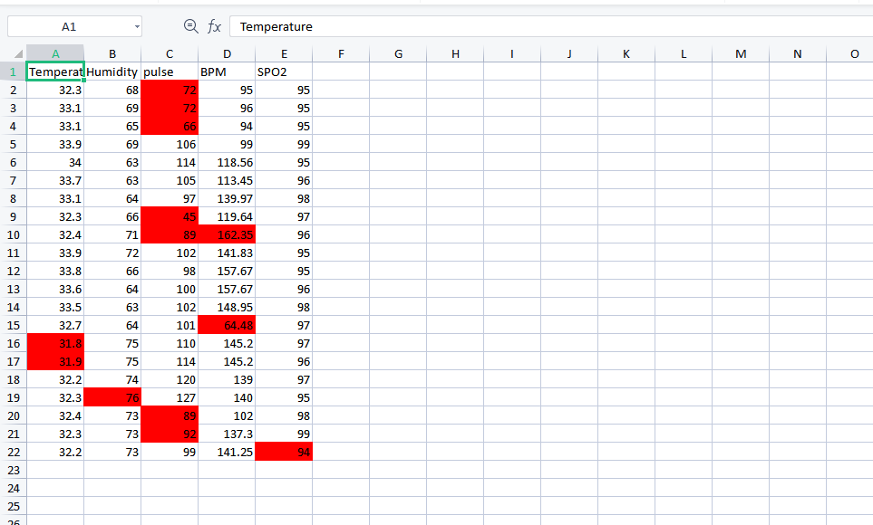

Slide 15
INTEGRATING ISOLATION FOREST AND TWILIO
By connecting sensors to Thingspeak, developers can use Twilio to send alerts when values fall outside of a specified range.
However, not all abnormal values are created equal. Some may be due to natural fluctuations, while others may indicate a serious problem.
To distinguish between the two, developers can use an isolation forest algorithm.
This algorithm is designed to identify anomalies in data sets by isolating them from the rest of the data.
Using Twilio applications and the isolation forest algorithm together allows for more accurate detection of abnormal values.
Developers can set up customized alerts based on the severity of the anomaly, ensuring that they are notified only when necessary.
This can help prevent false alarms and ensure that issues are addressed promptly and efficiently.

Slide 16
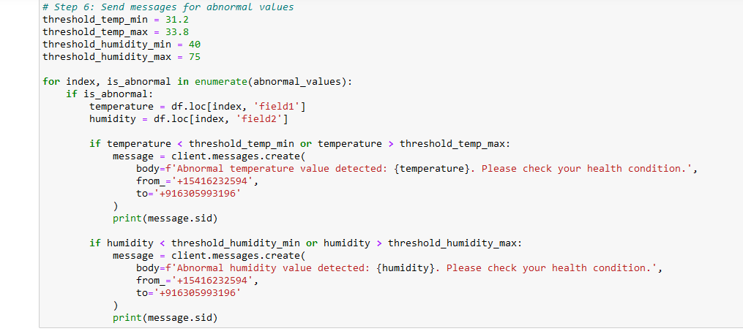

Slide 17
About Twilio Application to Send SMS and Email
Twilio is a cloud communications platform that enables developers to build, scale, and operate real-time communications within software applications.
One of the features of Twilio is its ability to send SMS messages and emails to any phone number or email address.
This feature can be integrated into any application with just a few lines of code, making it easy for developers to add communication capabilities to their applications.
With Twilio, developers can customize the content of their SMS messages and emails, as well as the sender ID.
They can also track the status of each message sent, including whether it was delivered or not.
This makes it easy to monitor the performance of the communication feature and make necessary adjustments.

Slide 18
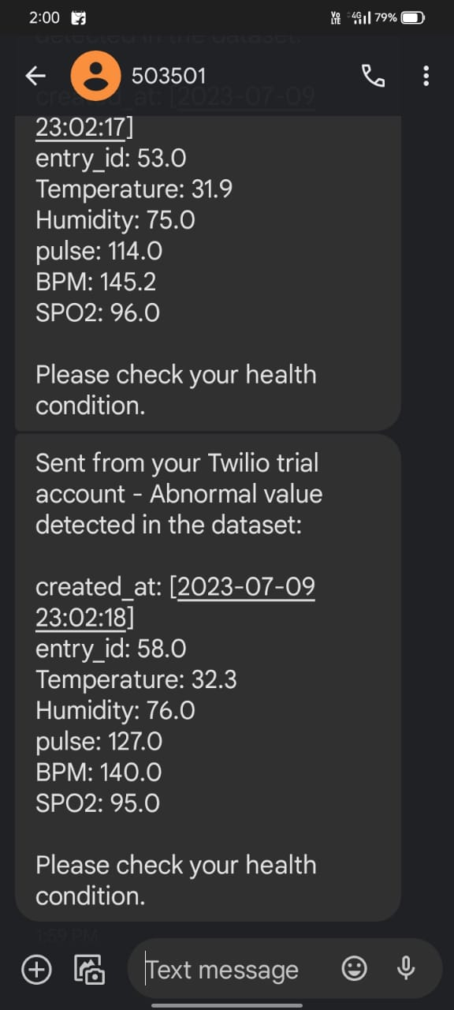

Slide 19
DATA AGGREGATION
Data aggregation is the process of collecting, organizing, and summarizing data from various sources into a cohesive and meaningful format. It involves gathering data from different systems, databases, or files and combining it to create a comprehensive view or analysis of the information.
Key points:
Data Collection
Data Cleaning and Transformation
Data Integration
Summarization and Calculation
Analysis and Reporting

Slide 20
STEPS TO AGGREGATE DATA
Step 1: Data cleanup
Remove columns with empty values.
Remove rows with empty values.
Step 2: Data manipulation
--- Create week, month and year columns from the date columns
Step 3: Colour Scales
Step 4: Create Pivot Table
--- Sparlines for trends, Data bars

Slide 21
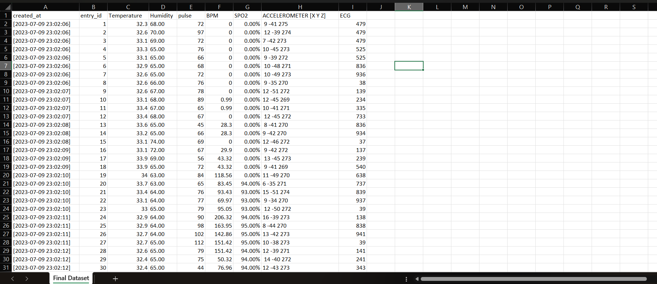
STEP – 1 : DATA CLEANUP

Slide 22
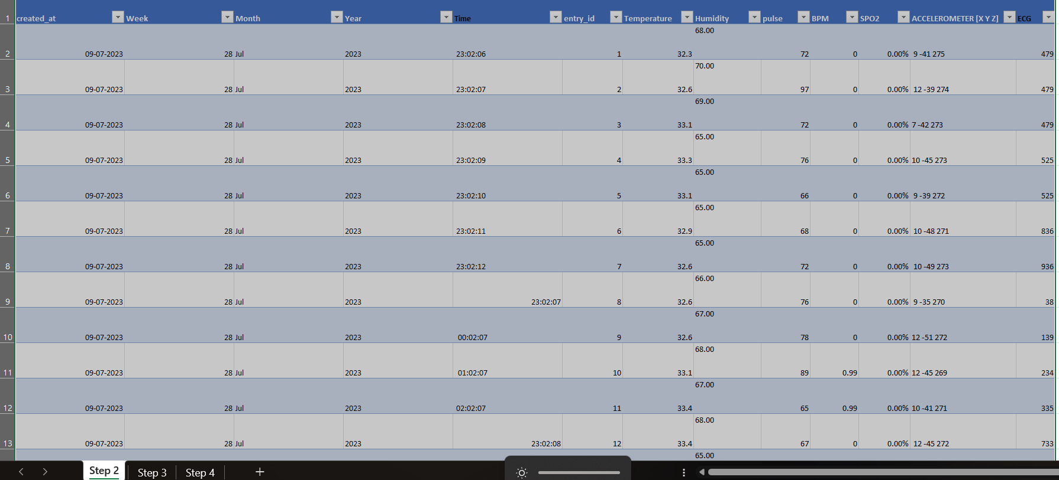
STEP – 2 : DATA MANIPULATION

Slide 23
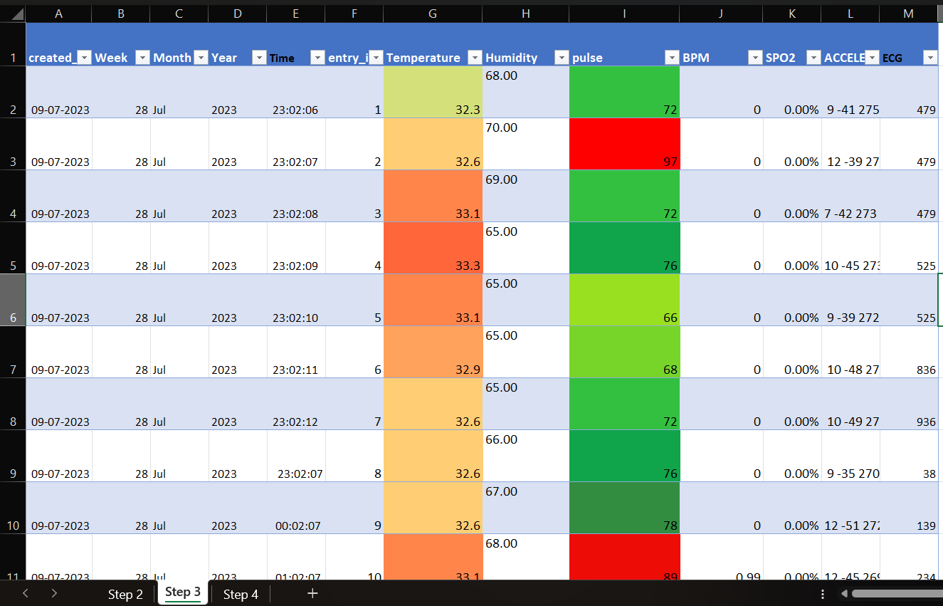
STEP – 3 : COLOUR SCALES

Slide 24
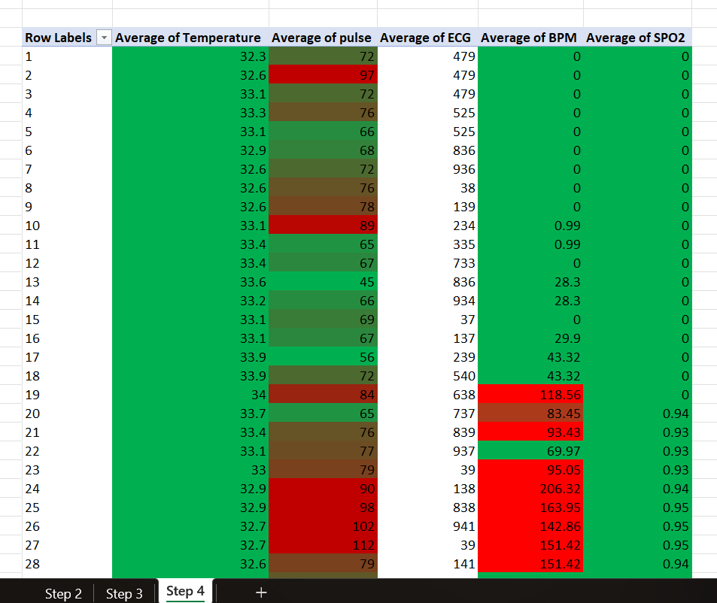
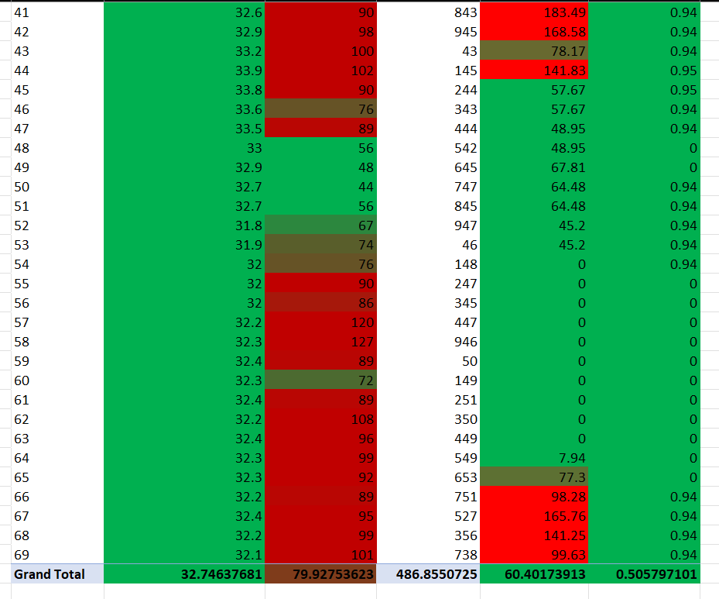
STEP – 5 : CREATE PIVOT TABLE

Slide 25
CONCLUSION
In conclusion, we have learned about the importance of interfacing sensors and Nodemcu with Thingspeak. By doing so, we can collect and analyze data in real-time, enabling us to make informed decisions and take appropriate actions. We have also seen how easy it is to interface a sensor with Nodemcu and transmit the data to Thingspeak using simple step-by-step instructions.By exploring the possibilities of using this technology in their own projects, the audience can create innovative solutions that can benefit society as a whole. Whether it's monitoring environmental conditions, tracking inventory levels or optimizing energy consumption, the applications of this technology are endless. So let's embrace the power of IoT and start building the future today!

Slide 26


